Slide 1

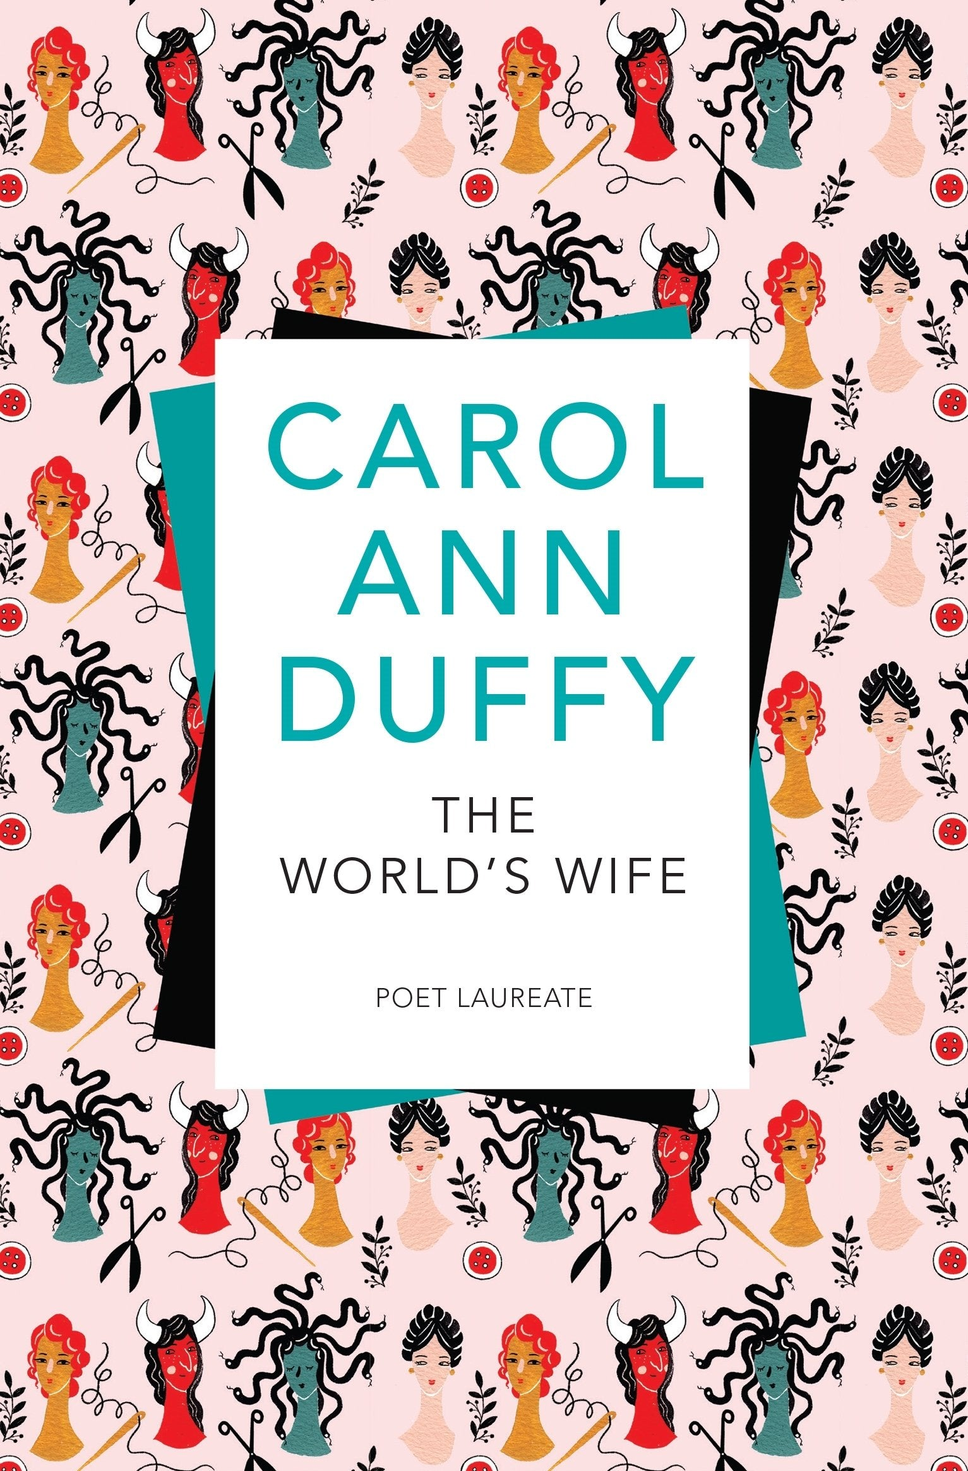
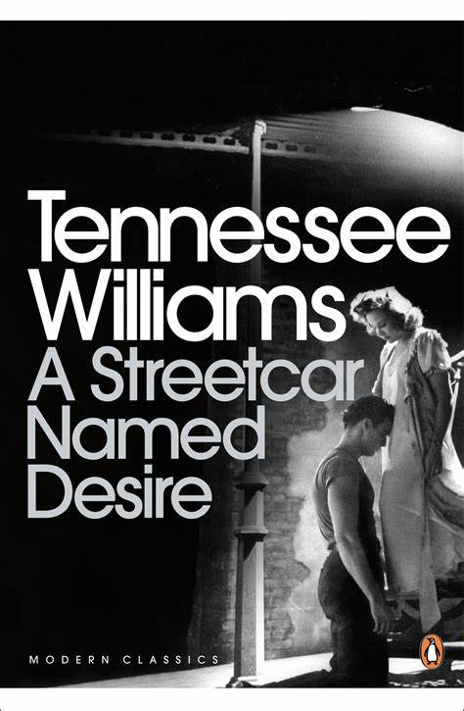


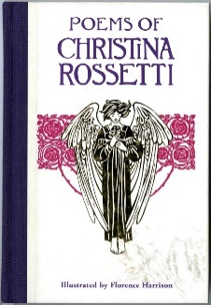


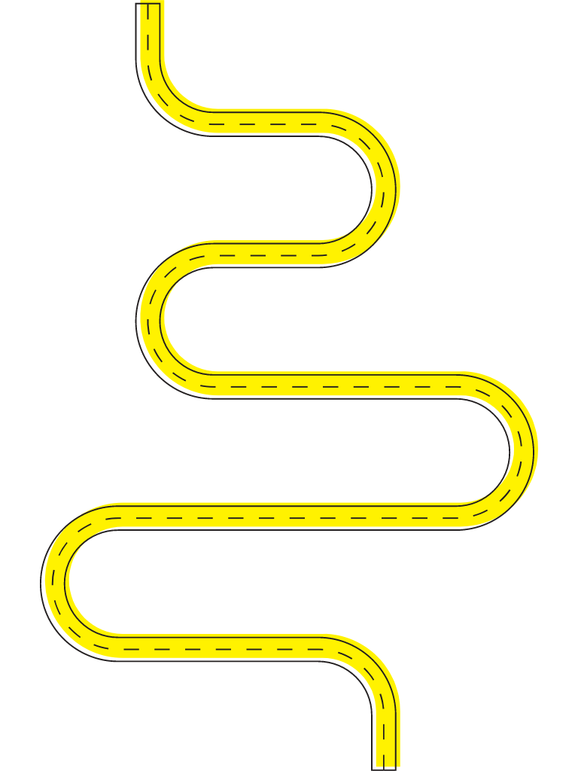
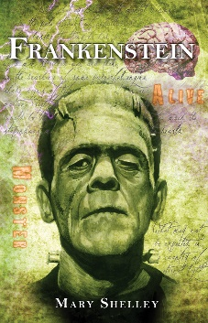
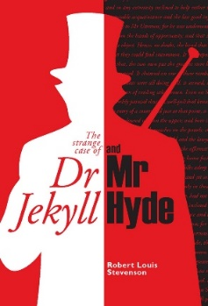

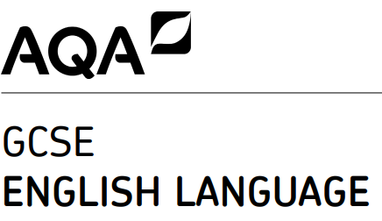
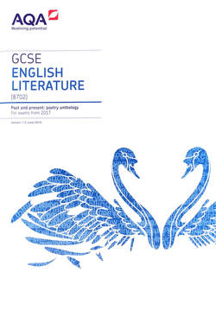

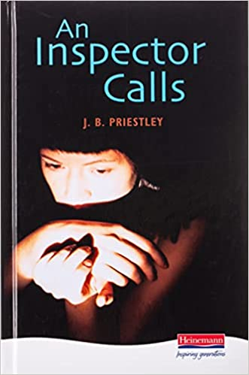

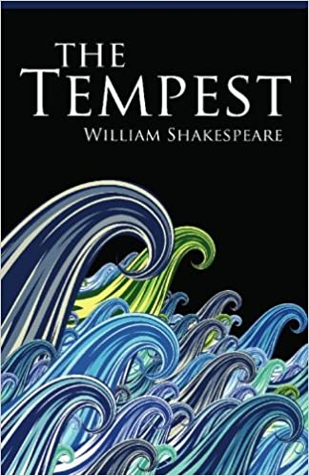

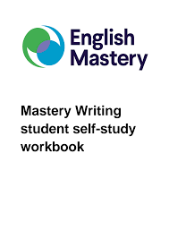



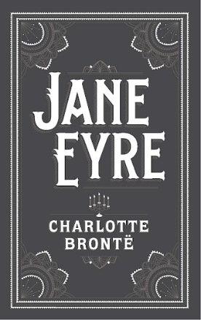


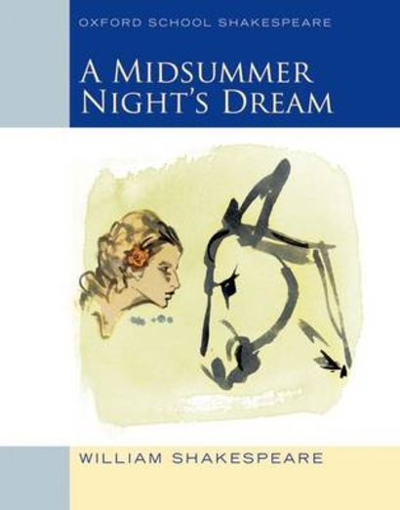
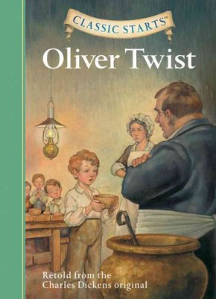
English at Bolder
Shakespeare:
Twelfth Night
Poetry:
Rossetti
Coursework:
-A Streetcar Named Desire
-The World’s Wife
-student choice of text
Modern drama:
A Doll’s House
Gothic texts:
-Frankenstein
-The Bloody Chamber
-Unseen Gothic
English Literature Paper 1: Jekyll and Hyde
6th form
English Language Paper 2
Year 11
English Literature Paper 2: An Inspector Calls
English Language Paper 1
English Literature Paper 2: Poetry Power & Conflict
English Literature Paper 1: Macbeth
Year 10
Shakespeare:
The Tempest
Begin:
Poetry Power & Conflict
Allegory:
Animal
Farm
Victorian short stories:
Sherlock
Year 9
Year 8
Reading for Pleasure
Poetry:
Metaphors
Shakespeare:
Romeo and Juliet
Year 7
Victorian novel:
Jane Eyre
Shakespeare:
A Midsummer Night’s Dream
Victorian novel: Oliver Twist
Mastery Writing:
Technical accuracy & creative writing

